Slide 1
SOLVEDOKU

Slide 2
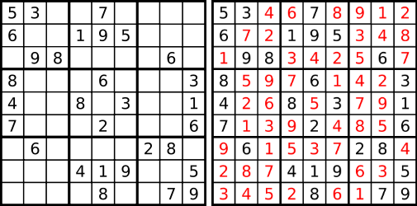
Introduction
SOLVEDOKU solves Sudoku puzzles using image recognition
SOLVEDOKU offers several benefits for the user
Allows for a quick solution to a newspaper Sudoku puzzle
Offers an easier solution finder than a text input Sudoku solver

Slide 3
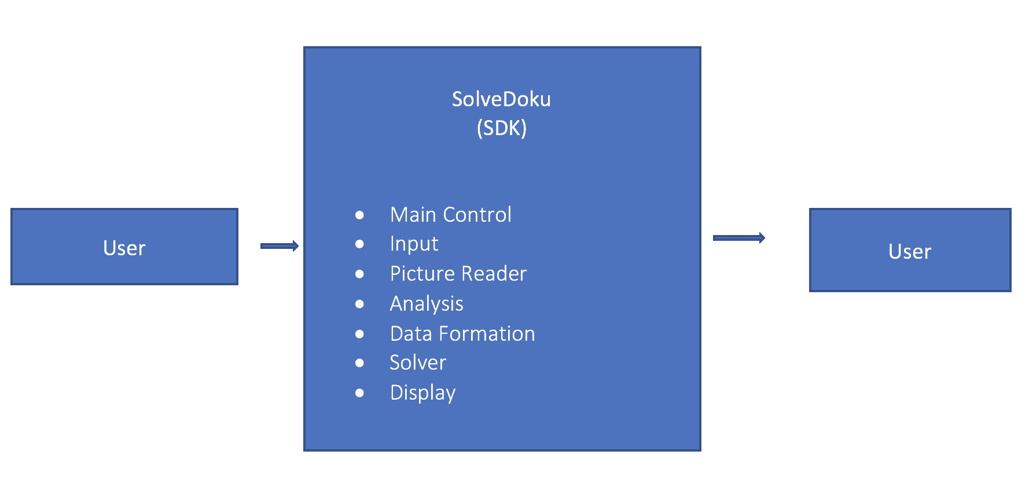
DFD LEVEL 0

Slide 4
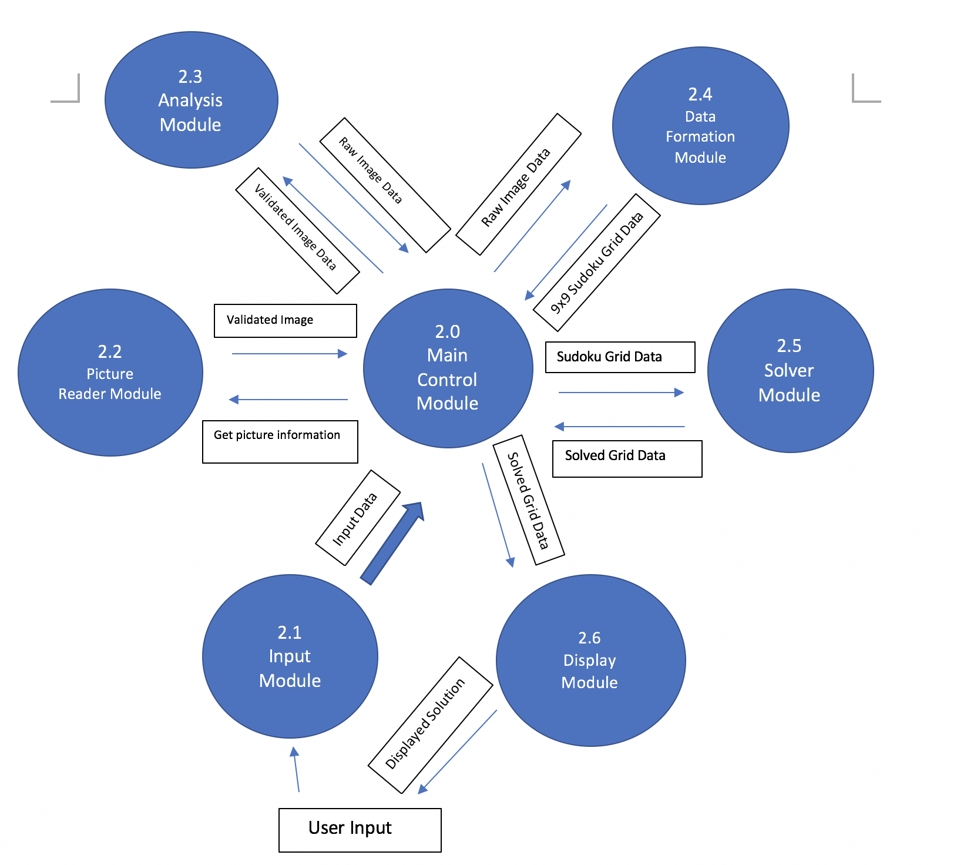
DFD LEVEL 1

Slide 5
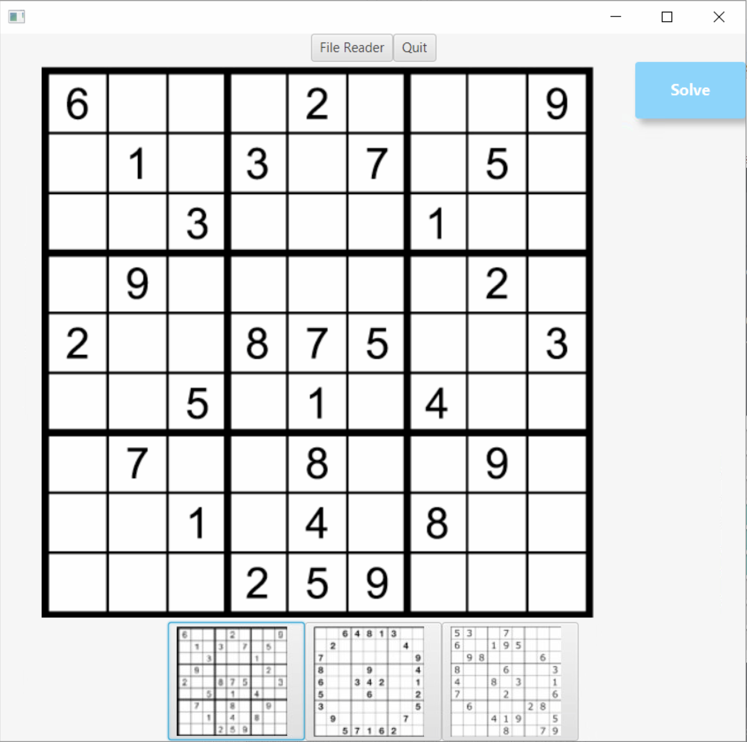
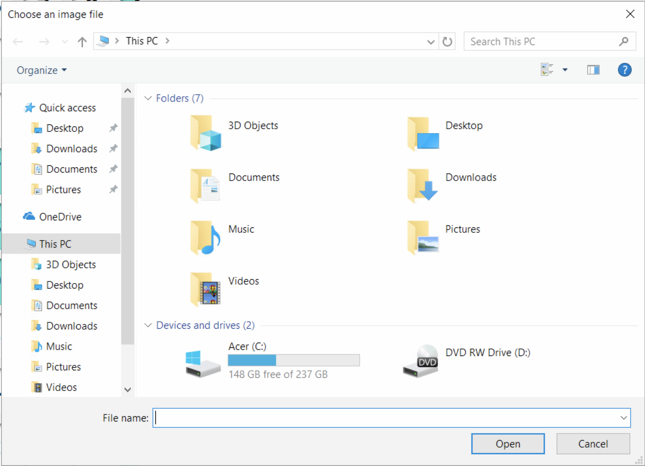
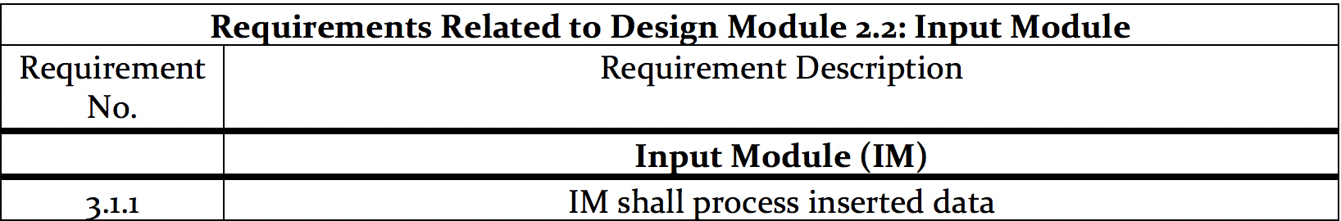
Input Module

Slide 6
DFD LEVEL 1

Slide 7
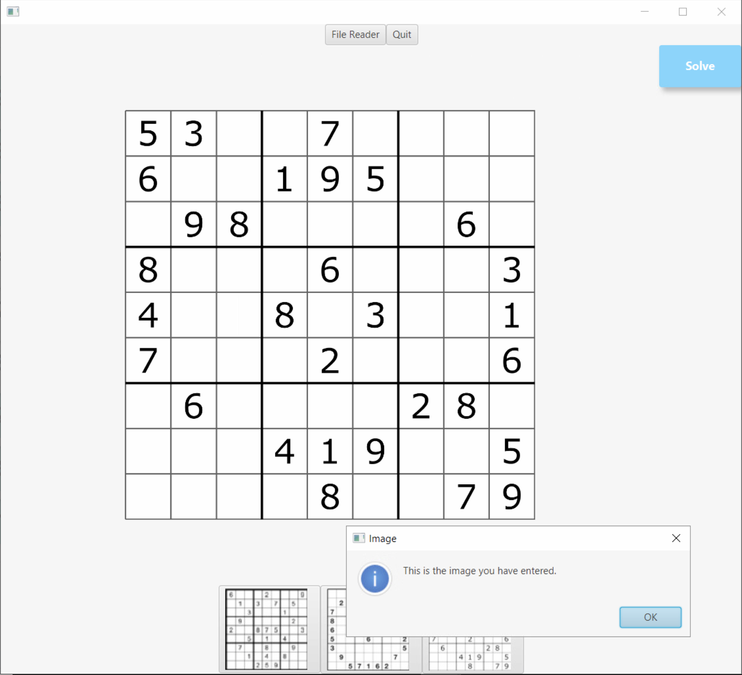
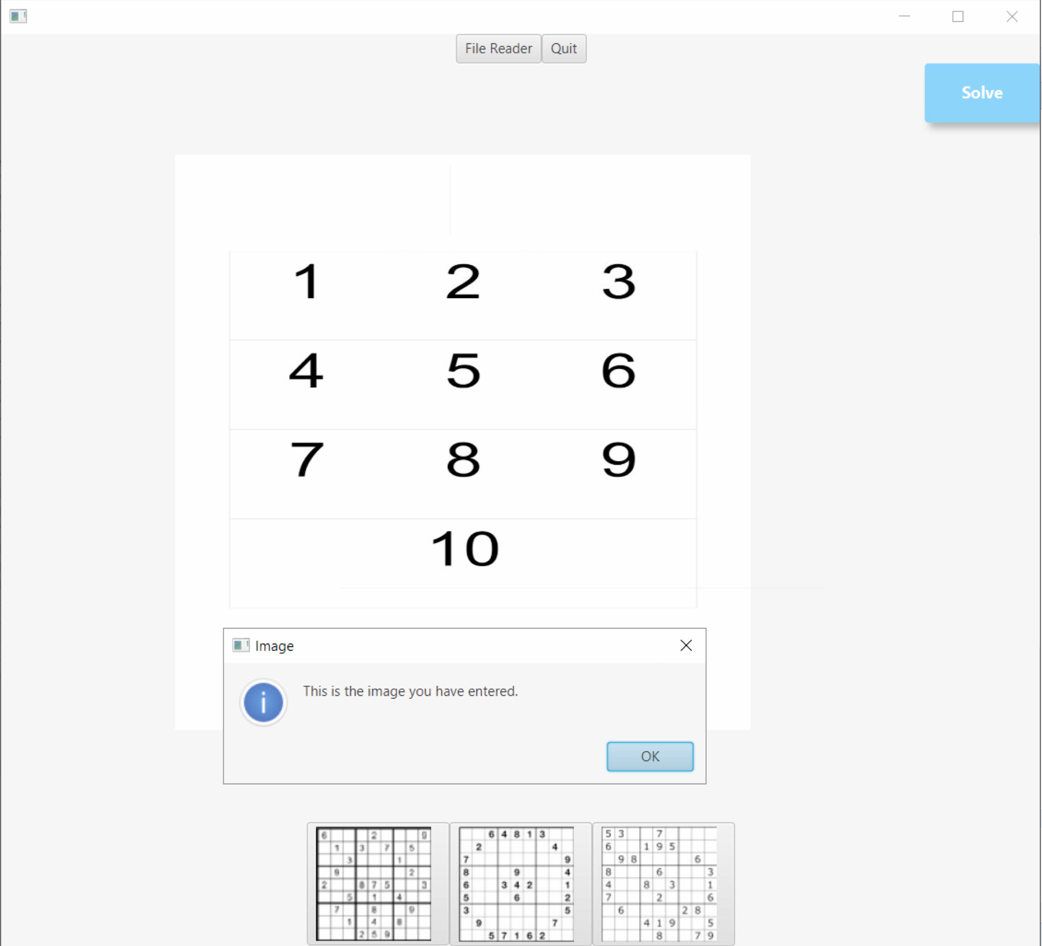
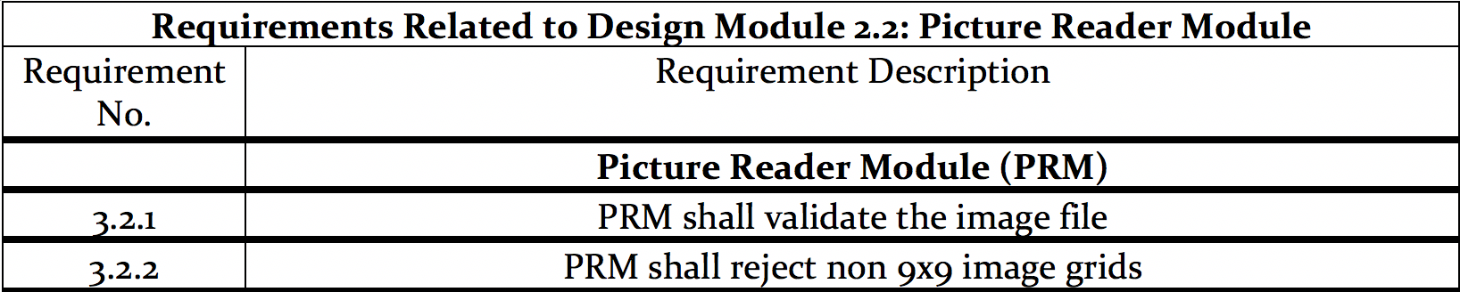
Picture Reader Module

Slide 8
DFD LEVEL 1

Slide 9
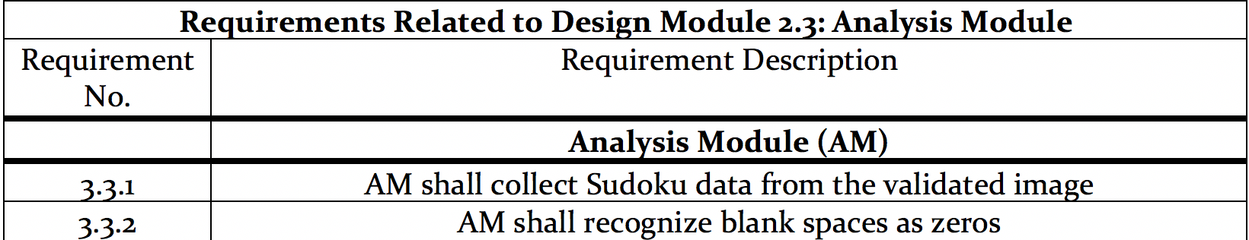
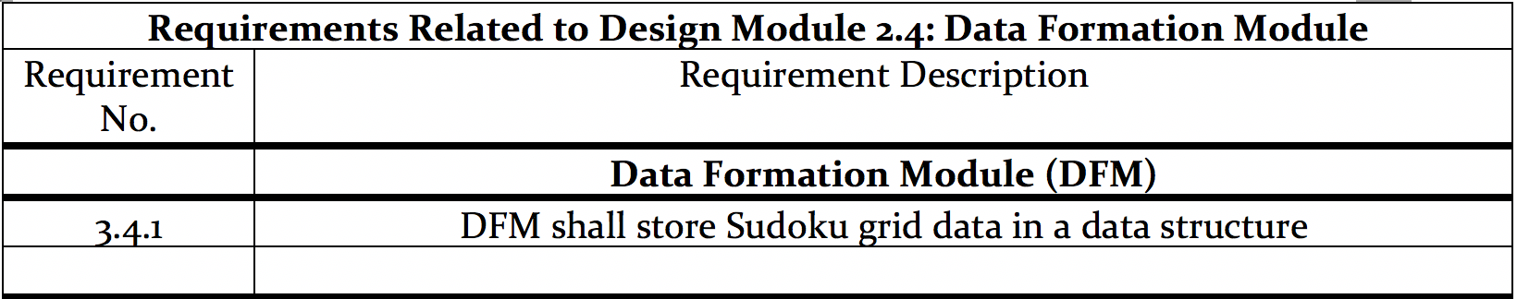
Analysis and data formulation module

Slide 10
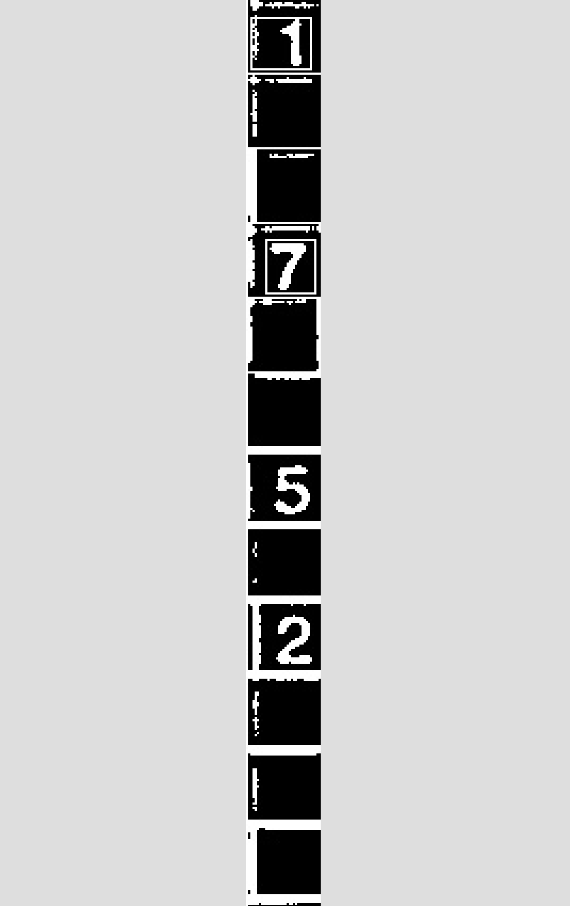
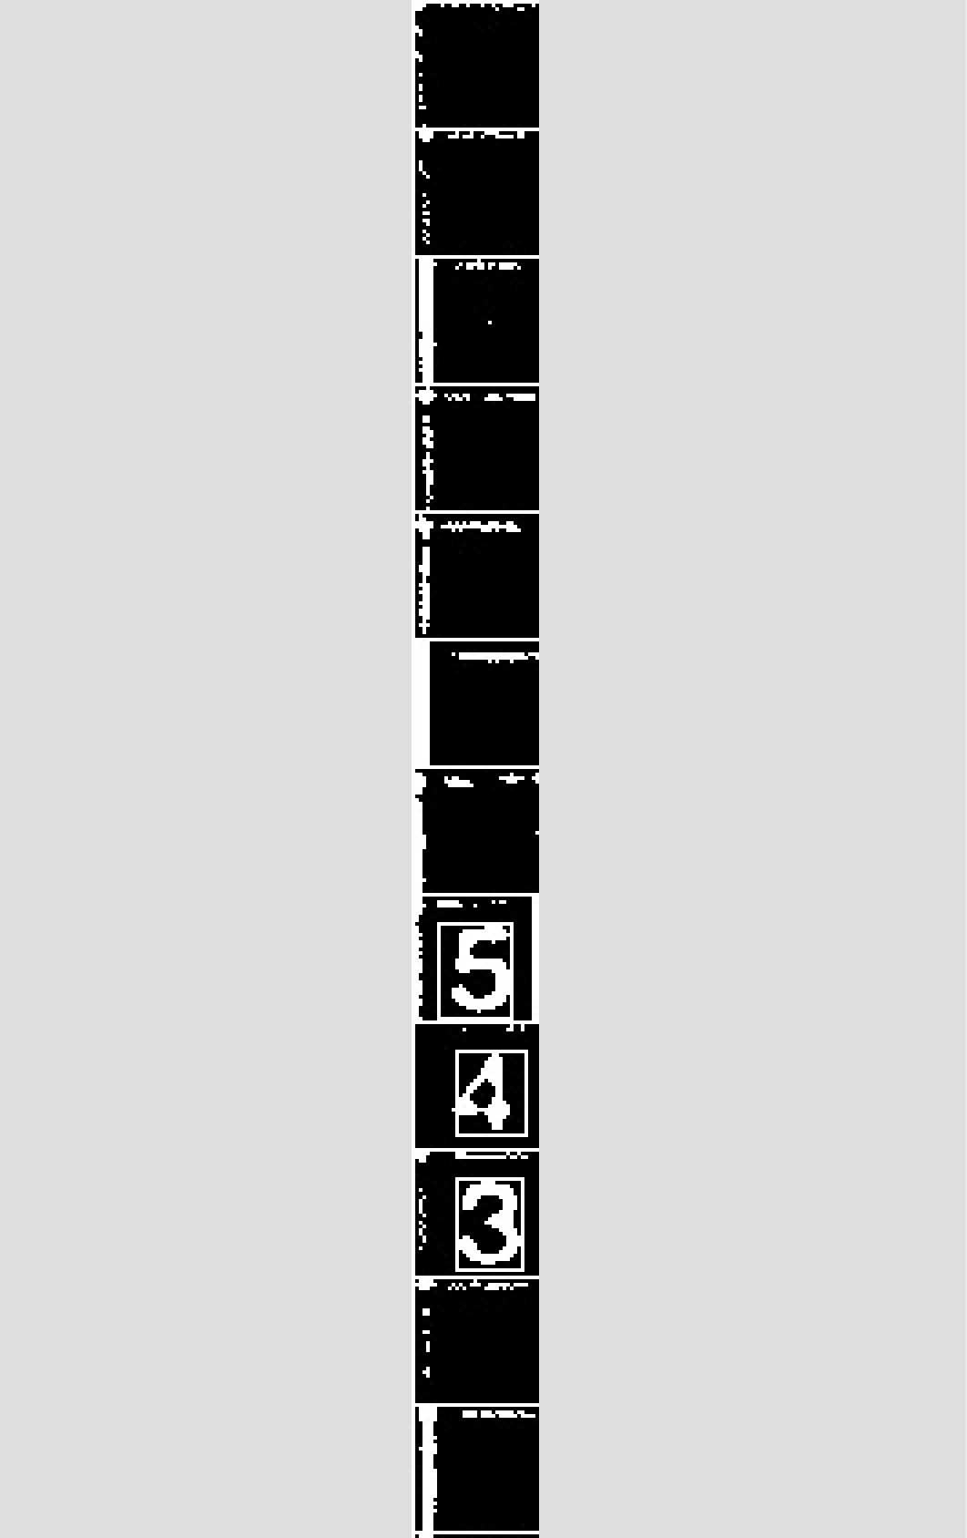
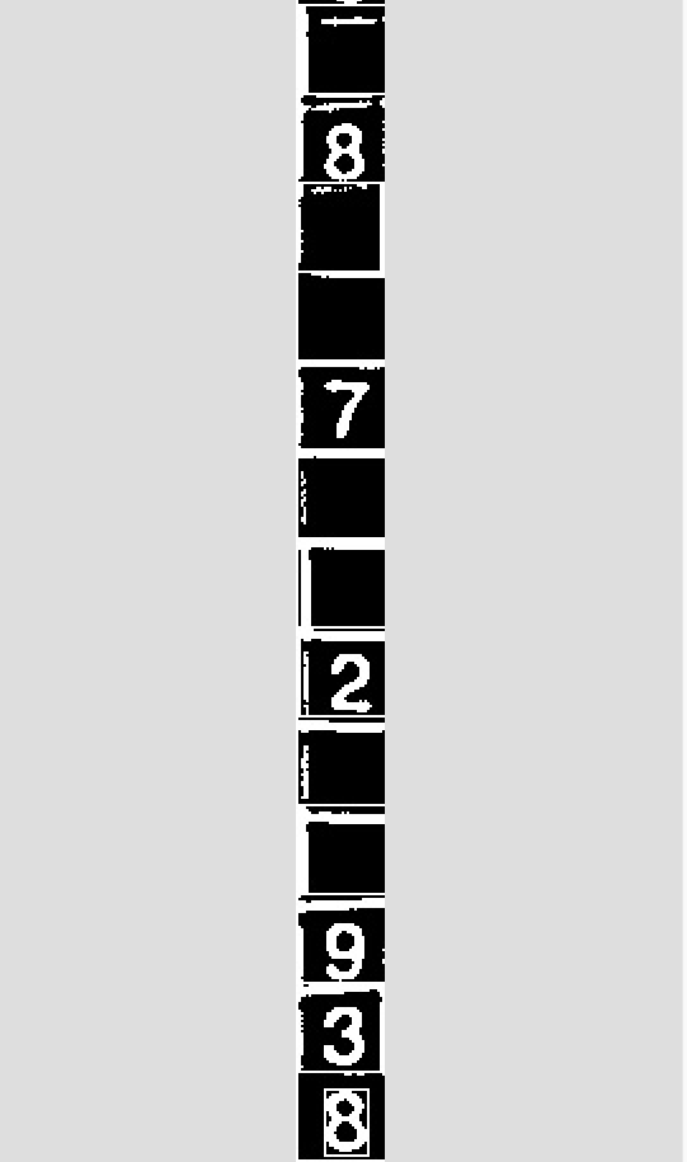
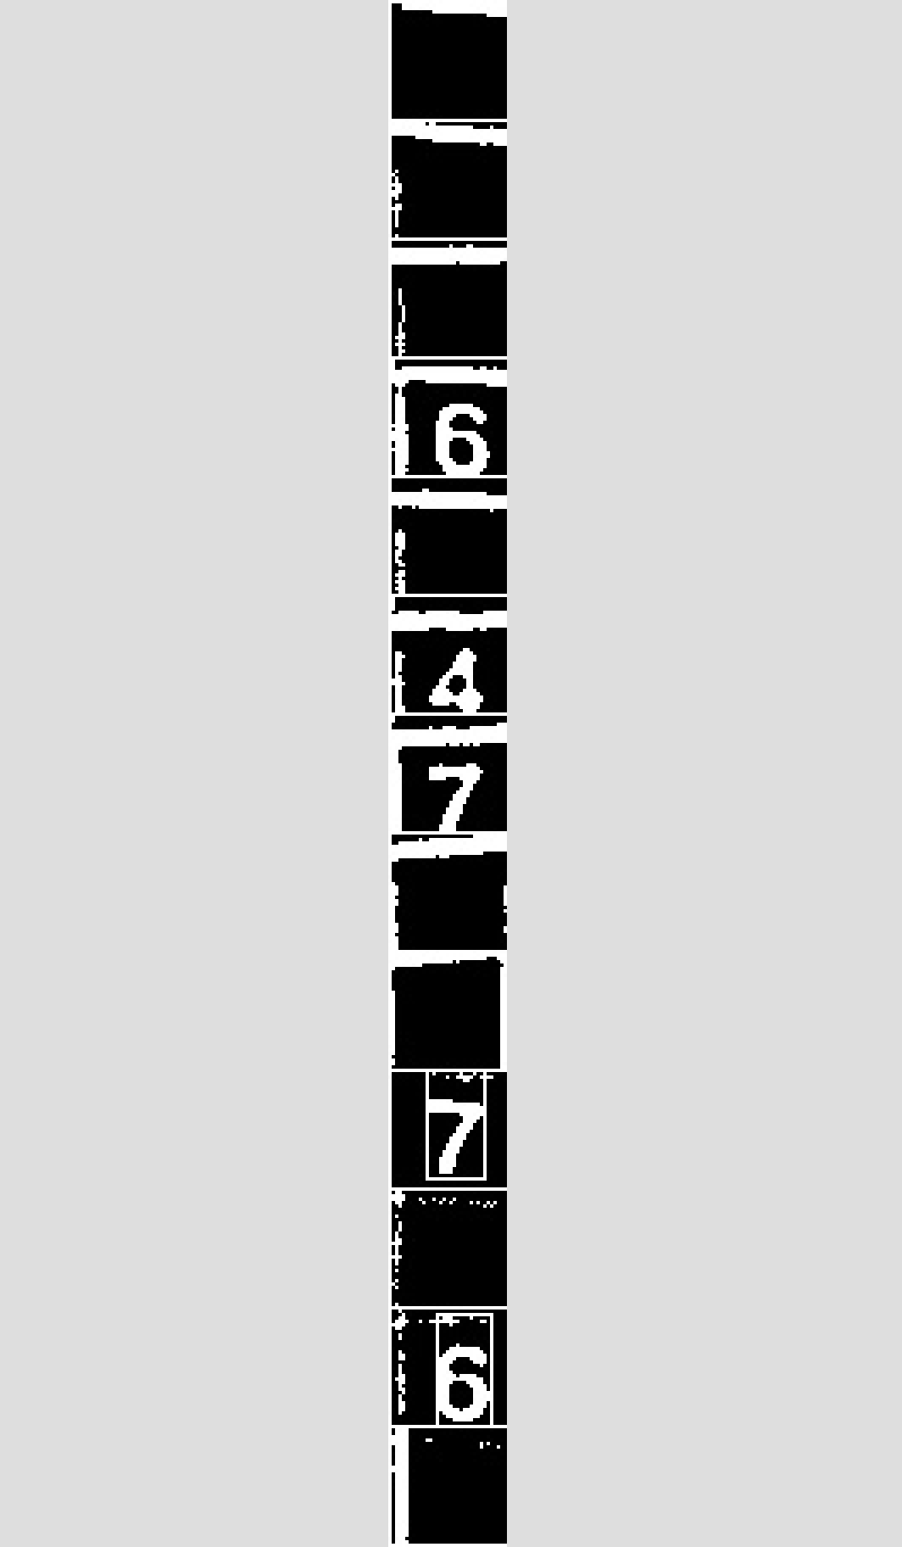

Analysis and data formulation module cont.

Slide 11
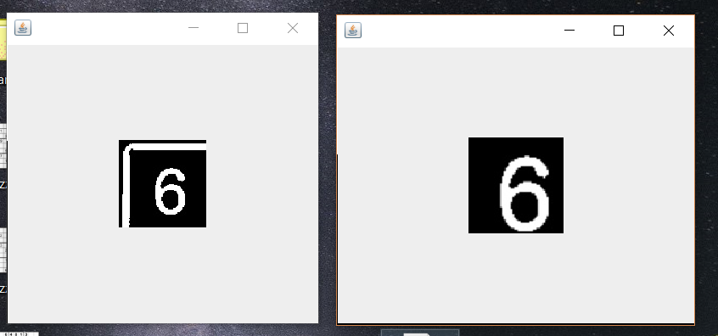
Analysis and data formulation module cont.

Slide 12
DFD LEVEL 1

Slide 13
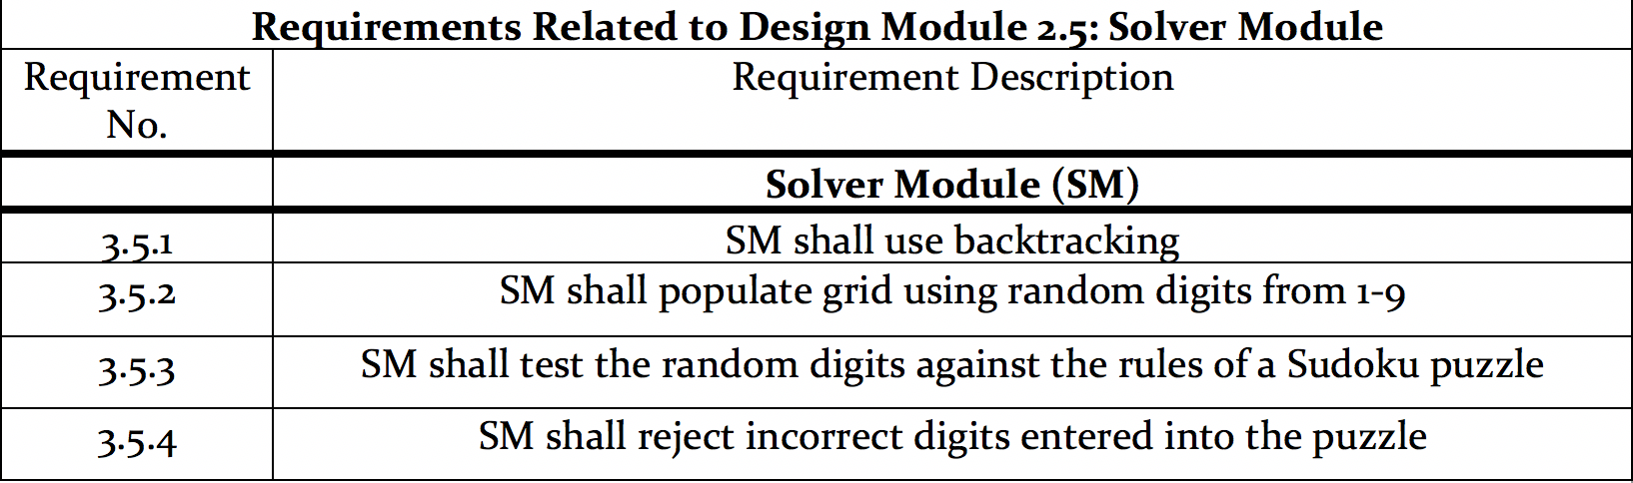
Solver Module

Slide 14
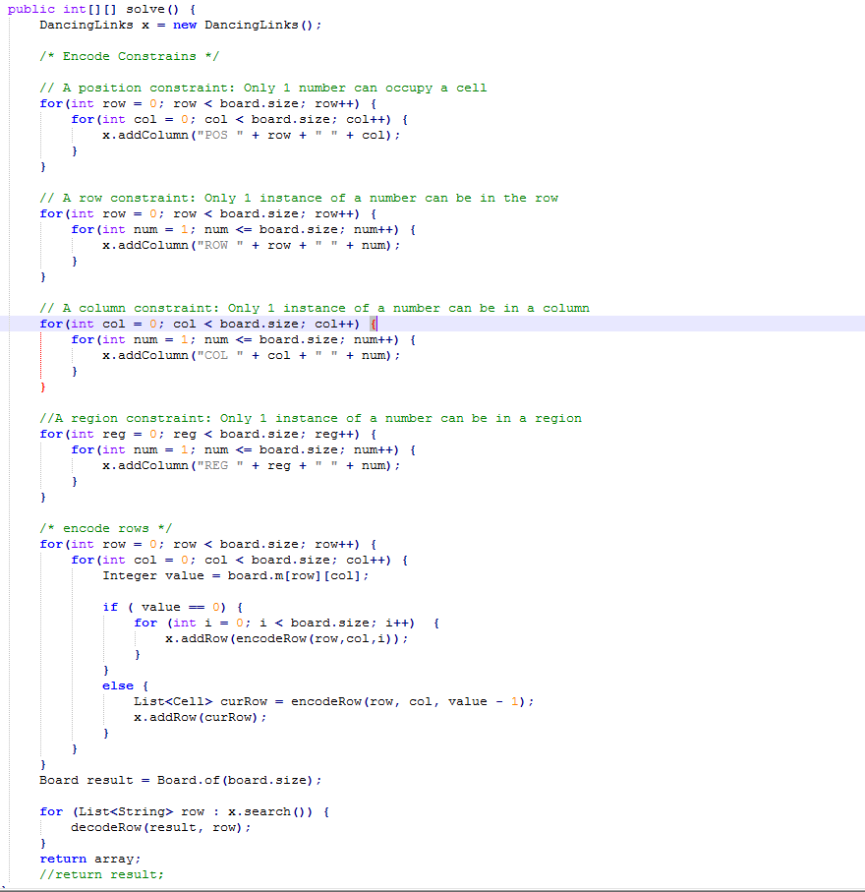
Solver Module cont.

Slide 15
DFD LEVEL 1

Slide 16
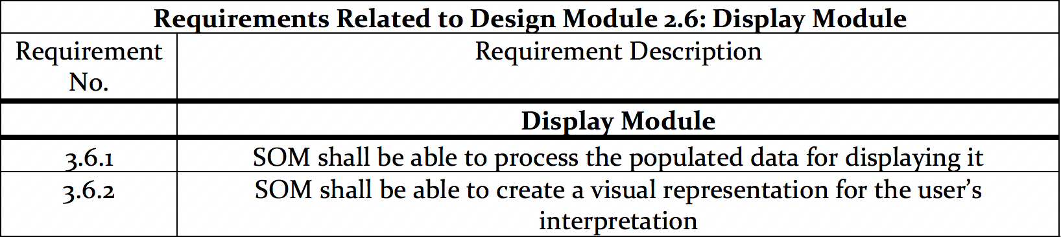
Display Module

Slide 17
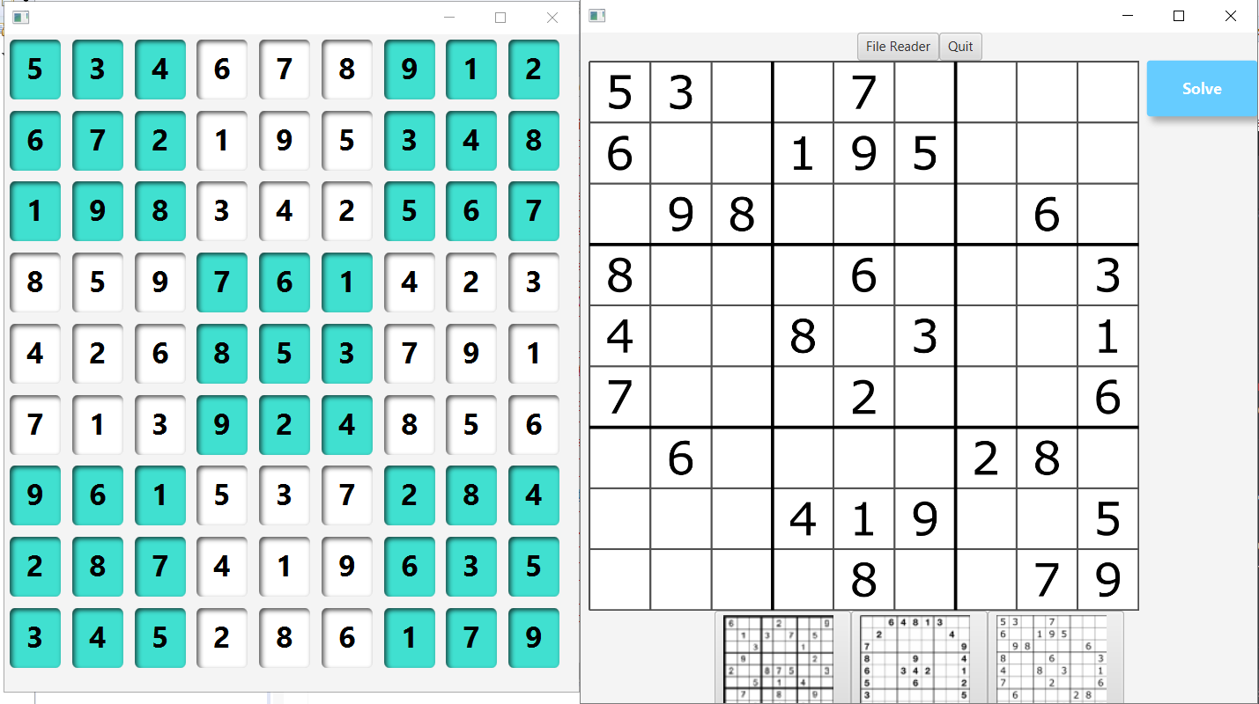
Display module

Slide 18
Main Control Module
Provides mechanisms (mainly buttons) to control the features.

